Slide 1



G H RAISONI INSTITUTE OF ENGINEERING AND TECHNOLOGY, NAGPUR
(Approved by AICTE, New Delhi and Recognized by DTE, Maharashtra)
An Autonomous Institute Affiliated to Rashtrasant Tukadoji Maharaj Nagpur University, Nagpur
Accredited by NAAC with A+ Grade
Department of Data Science
Project Quality Assurance Initiative 2023-24
On
AI BASED FAKE SOCIAL MEDIA PROFILE DETECTION AND REPORTING
Name of Projectees: G8
Hariom Shukla Tanisha Shahare
Harshani Zodape Aditi Shukla
Guided By:
Dr. Swapnili Karmore

Slide 2
Contents
Introduction
Literature Survey
Problem Statement
Objective of Project
Methodology
Implementation
Work done
Innovative work (If any)
Results
Conclusion & Future Scope
Publication / Presentation / Project Competition
References

Slide 3
Introduction
Social media like Twitter, Facebook, Instagram, and LinkedIn are an integral part of our lives.
People all over the world are actively engaged in these social media platforms. But at the same time, it faces the problem of fake profiles.
Fake profiles are generally human-generated or bot-generated or cyborgs, created for spreading rumors, phishing, data breaching, and identity theft. Therefore, in this article, we discuss fake profile detection models.
These differentiate between fake profiles and genuine profiles on Twitter based on visible features like followers count, friends count, status count, and more. We form the models using various machine learning methods.
We use the MIB dataset of Twitter profiles, TFP, and E13 for genuine and INT, TWT, and FSF for fake accounts.
Here, we will be test different ML approaches, such as Neural Networks, Random Forest, XG Boost.

Slide 4
Literature Survey
Sr. No. | Paper Title and its Author | Details of Publication | Findings
1 | Fake Account Detection on Social Media using Random Forest Classifier. Author:-Kanti.Bhavya; Usha Nanadani;Kancharia. | June 20223 IEEE ISSN: 2768-5330 | It used three ML algorithm logistic,decision tree,random forest and best accuracy obtain by random forest
2 | Fake and Clone Account Detection in Online Social Networks Authors:-K Mohanapriya; N Sangavi; A Kanimozhi; V R Kiruthika | March 2023 IEEE ISSN: 2691-4581 | It use FFNN and Neural network and get better accuracy on recall and precision
3 | SVM Based Fake Account Sign-In Detection Authors:-S.R. Ramya; R. Priyanka; S. Siva Priya;R. Srinivashini. | May 2023 IEEE ISBN:979-8-3503-9728 | In this fake account are identified in the browser this technique used two algorithm (NN,SVM)

Slide 5
Problem Statement
1. Definition of faux Profiles: in reality outline what constitutes a faux social media profile. this will consist of impersonation debts, bots, unsolicited mail money owed, or some other form of fraudulent on line identification.
2. Detection methods: Describe the techniques and algorithms used to discover fake profiles. this will consist of studying consumer behaviour including posting patterns, engagement and content material fine, or the usage of device learning models to stumble on anomalies. further, incorporating natural language processing into the content analysis of posts and feedback may be an effective technique.
3. Information sources: Identify the statistics sources with a view to be used for detection. this may consist of user-generated content, account advent statistics, or outside statistics assets for move-referencing and verification.
4. Scalability: Addressing scalability problems while detecting fake profiles on platforms with hundreds of thousands or even billions of customers. The device ought to be capable of procedure massive amounts of statistics in real time.
5. Reporting Mechanism: Describe how customers can report suspected faux profiles and the system for verifying those reviews. this may encompass human moderators, AI systems, or a aggregate of both.
6. User privacy: make certain that privacy worries are addressed, mainly when reporting and verifying faux profiles. shield person facts and observe information safety guidelines.

Slide 6
Problem Statement
7. False Positives and Negatives: Be conscious that detection structures can produce fake positives (figuring out authentic debts as faux) and fake negatives (failing to become aware of fake debts). To mitigate the effect of such mistakes.
8. Regulatory Compliance: make certain that the detection and reporting system complies with relevant social media and privacy legal guidelines and guidelines.
9. User focus: sell consumer training and cognizance of the dangers associated with fake profiles and encourage responsible reporting.
10. Monitoring and feedback: put in force continuous tracking and feedback loops to enhance the accuracy of the detection system over time.
11. Go-Platform Collaboration: work with different social media platforms and enterprise stakeholders to share pleasant practices and statistics to together fight fake profiles.
12. Impact evaluation: Measuring the effectiveness of the detection and reporting machine in reducing the superiority of faux profiles and their terrible consequences on the platform.
In end, the problem of detecting and reporting faux social media profiles is a multi-faceted challenge that requires the combination of superior technology, accountable statistics managing and collaboration among various stakeholders to create a more secure and greater proper on line surroundings.

Slide 7
Objective of Project
Improve platform security: Improve the security and integrity of social media platforms by identifying and reducing the presence of misinformation that could lead to fraud.
Reduce misinformation: Reduce the spread of misinformation, rumors and disinformation, often caused by misinformation.
Prevent cyberbullying and bullying: Help prevent cyberbullying and bullying by identifying and reporting fake or fake accounts.
Protect the user's privacy: Ensure that the user's data is not misused to be converted into personal data for malicious purposes, thus protecting the user's privacy and the security of platform users.
Build trust: Build trust among users by demonstrating the platform's commitment to maintaining a trustworthy and safe online community.
Empower users: Empower users to participate in the integrity management of the platform by giving them the opportunity to report sensitive personal information.
Promoting a good online experience: Provide social media users with a good online experience and build trust and happiness online.
In summary, the aim is to use technology and reporting techniques to identify, report and reduce the impact of misinformation on social media, thus making online interactions safe and reliable for all users.

Slide 8
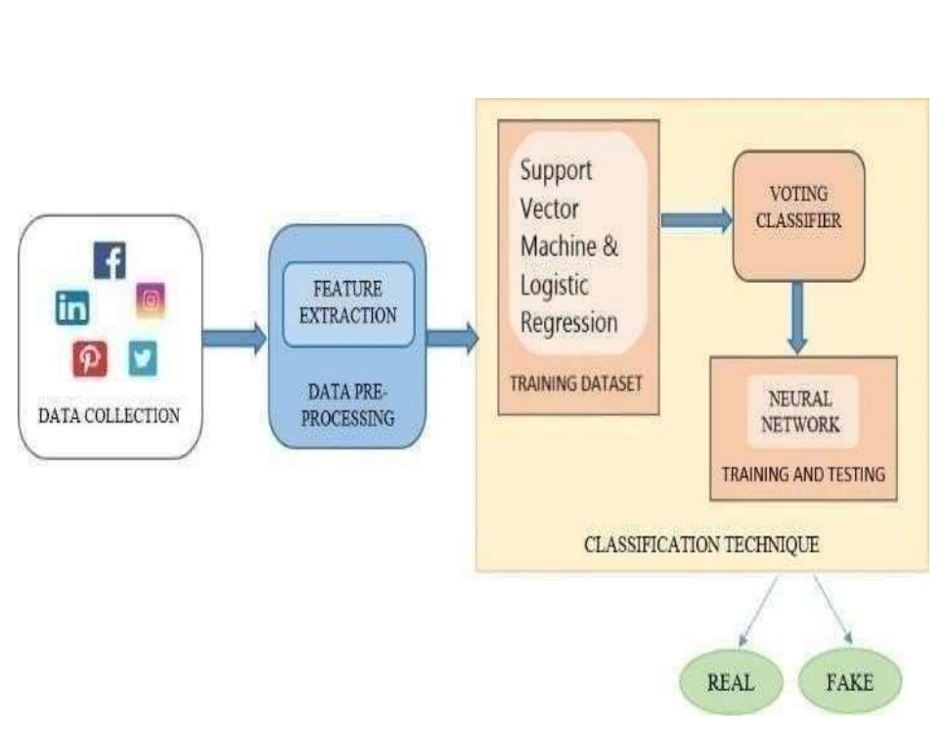
Proposed Methodology

Slide 9
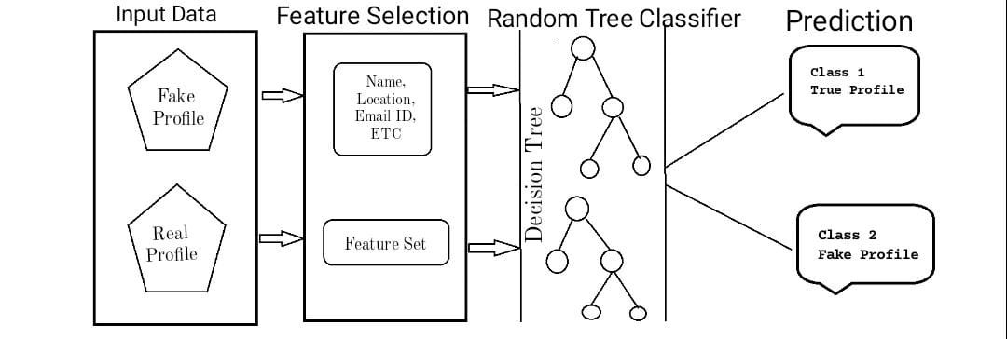
Implementation

Slide 10
Innovative Work ( if any)
Machine Learning Algorithms: Uses advanced machine learning techniques such as deep learning and predictive language processing to analyze profile data, post content, and the user's attitude towards inequality.
Content Review: Carefully review published content, including text, images, and links, for signs of spam, plagiarism, or inconsistency.
Account verification methods: Use multiple authentication and authentication methods to ensure the authenticity of the user's identity.

Slide 11
Work done
Problem Definition: I embarked on the project to address the rising issue of fake profiles on social media platforms, aiming to develop an AI-based solution for accurate detection.
Data Collection: Extensive data gathering was carried out, encompassing diverse sources of profile information, text, images, and social connections to create a robust training dataset.
EDA: We have used pandas profiling for EDA data analysis and statical information.
Model Development: Utilizing deep learning techniques and neural networks, a custom model was designed, featuring layers for data processing, feature extraction, and classification.
Training and Evaluation: The model was trained on the labeled dataset, optimizing performance metrics such as precision, recall, and accuracy through multiple iterations.
Real-World Application: The trained model was successfully applied to real-world scenarios, achieving promising results in identifying and flagging fake profiles on social media.

Slide 12
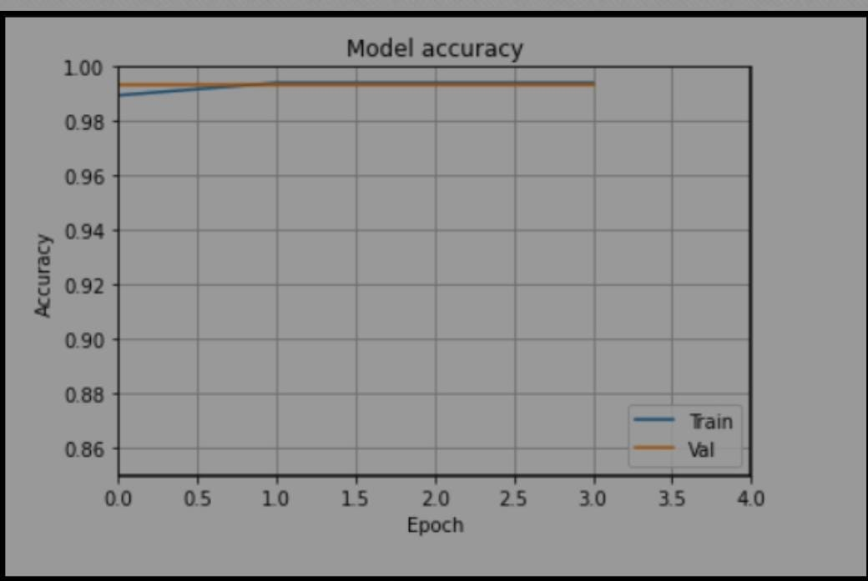
Results

Slide 13
Conclusion & Future Scope
In conclusion, checking social media profiles is an important task in today's digital age because it helps maintain the integrity, security, and authenticity of online interactions. Many new methods and methods have been developed to solve this problem. These include machine learning algorithms, graph analysis, behavioral biometrics, content analysis, account analysis, social media analysis, sentiment analysis, Information search, user guides, and blockchain solutions. Combining these techniques can improve the ability to identify and combat fake information on social media platforms. This ongoing effort is necessary to reduce the risks associated with misinformation, such as identity theft, misinformation, cyberbullying, and destruction of trust in the online community.

Slide 14
References
List of papers/books/websites etc refer for project
Journals
Prakas, K. (2011). Feedback and optimal sensitivity: Model reference transformations, multiplicative seminorms, and approximate inverses. IEEE Transactions on Automatic Control, 26(2): 301–320.
Text books
Myers, D. G. (2007). Psychology (1st Canadian ed.). Worth: New York.
Conference proceedings
Payne, D.B. and Gunhold, H.G. (1986). Digital sundials and broadband technology, In Proc. IOOC-ECOC, 1986, pp. 557-998.
Reports
Milton, M and Robert, L. (2004). Atmospheric carbon emission through genetic algorithm, Environment and Technical Report No.3., Indian Meteorological Department., New Delhi.

Slide 15
References
List of papers/books/websites etc refer for project
1.SocialNetworksFakeProfilesDetectionUsingMachineLearningAlgorithms
https://www.researchgate.net/publication/339012245/
2.Aleksei Romanov, Alexander Semenov, Oleksiy Mazhelis and Jari Veijalainen: Detection of Fake Profiles in Social Media
3.Sneha Kudugunta,Emilio Ferrara:Deep Neural Networks for Bot Detection
4. 4.Analysis and detection of fake profile over social network – Vijay Tiwari
5.https://www.irjet.net/archives/V6/i12/IRJET-V6I12189.pdf

Slide 16
Thank you !

